Slide 1
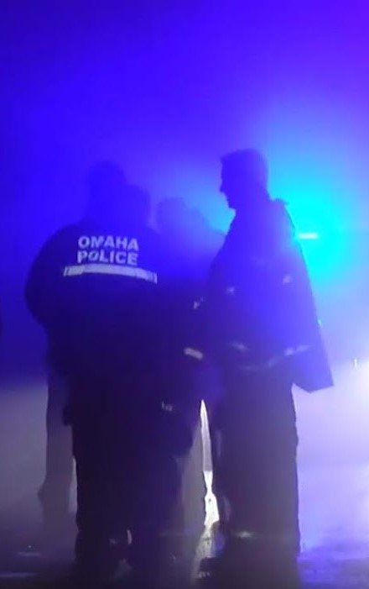
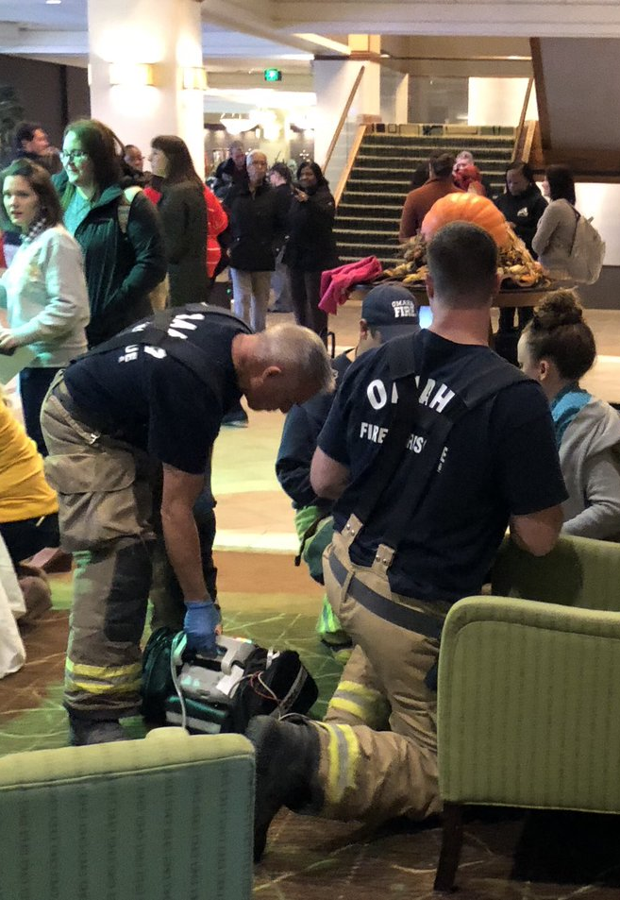
Orientation to
Emergency Operations
in Douglas County
Whitney Shipley, Assistant Director, EOC Manager
Douglas County Emergency Management Agency

Slide 2
Key Understandings and Planning Assumptions:
Information provided here today describes general practices for local community emergencies/natural disasters managed through traditional public safety and emergency management channels. Some exceptions apply.
Many variables influence incident response and management strategy and resource management options and operations.
Past incidents are not precedent setting.
Notes:
EXCEPTIONS
Public Health Emergencies
IncidentMedical
Incidents involving non-local agencies with jurisdiction (FAA, NTSB, FBI)
Public Health Emergencies
Incidents outside emergency management (eg COVID)
Public Health Emergencies (not same
Incidents managed outside emergency management (eg COVID)
Waivers
Incidents with federal involvement or oversight may be treated differently (Biocontainment)
Incidents that occur elsewhere may be treated differently (eg NDMS)
Note: While foundational concept is the same, there may be variation in implementation across jurisdictions.
VARIABLES
Community Emergency vs. Natural Disaster
Location of impacted area – “ground zero”
Facility emergency vs. community emergency
Insurable expense
Exercise frequently
Review and update agreements regularly
Maintain relationships
PRECEDENT
Test assumptions regularly
Exercise frequently
Review and update agreements regularly
Maintain relationships

Slide 3
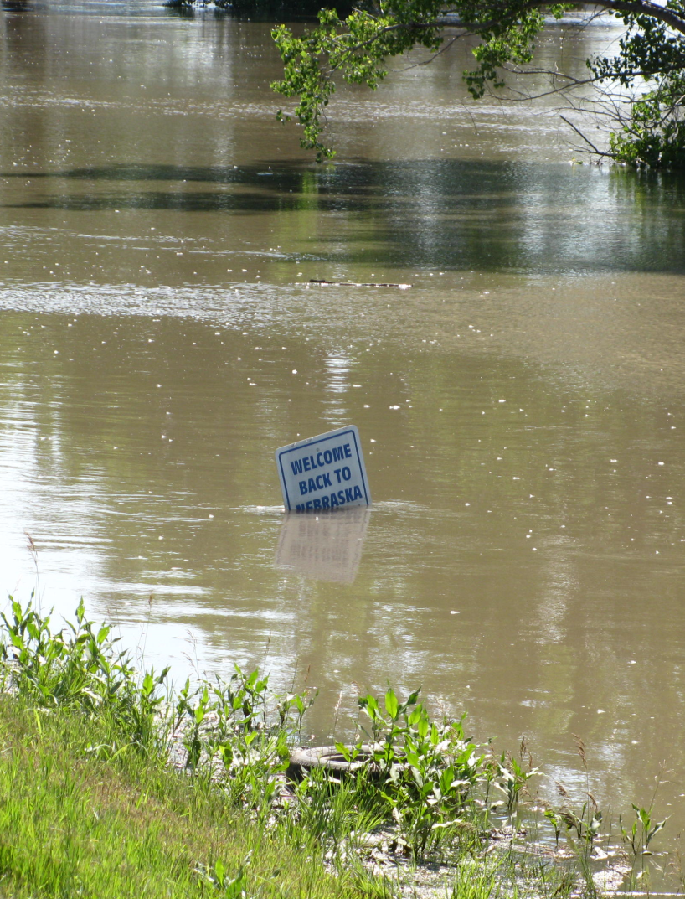
Overview
Threat, Vulnerability, and Risk
Damage Assessment
Disaster Management Cycle
Core Capabilities
Community Lifelines
Recovery Framework
Douglas County EMA and EOC Operations
Building Resilience through Public-Private Partnerships

Slide 4
Threat | Vulnerability | Risk
What types of occurrences might occur in Douglas County that hold the potential to negatively impact the health and safety of the community? Nebraska Emergency Management Act defines: Civil Defense Disaster Emergency (aka “CEND Incidents”) | For each of these types of incidents, what weaknesses exist that could be exploited by an aggressor or, in the case of a non-terrorist incident, make an asset or the community susceptible to damage? | Likelihood x Impact How likely is the event to occur here and what is the potential magnitude and type of impact, if it does?

Slide 5
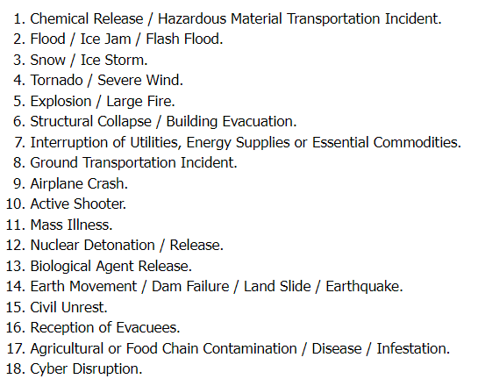
Threats Identified
for Douglas
County
Readyomaha.org or Readydouglascounty.org

Slide 6
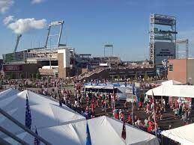
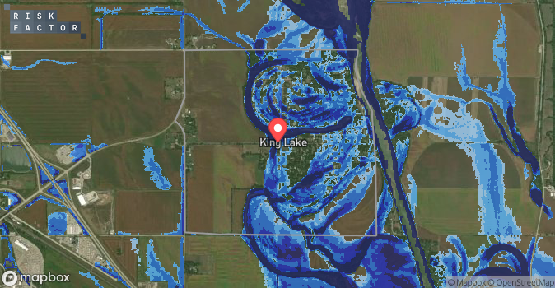
Elements of Vulnerability
Any weakness that can be exploited by an aggressor or, in a non-terrorist threat environment, make a community susceptible to hazard damage.
Example:
High water table
Limited access
Low water pressure
Fluctuations in water level
Population density

Slide 7
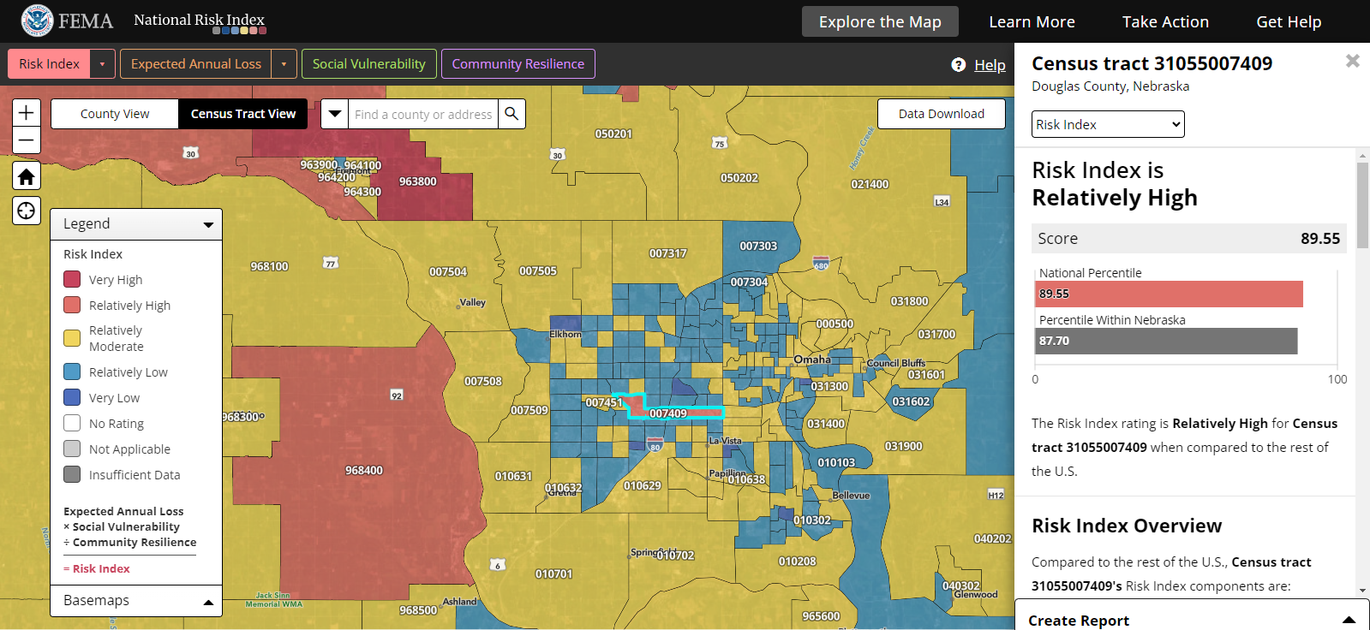
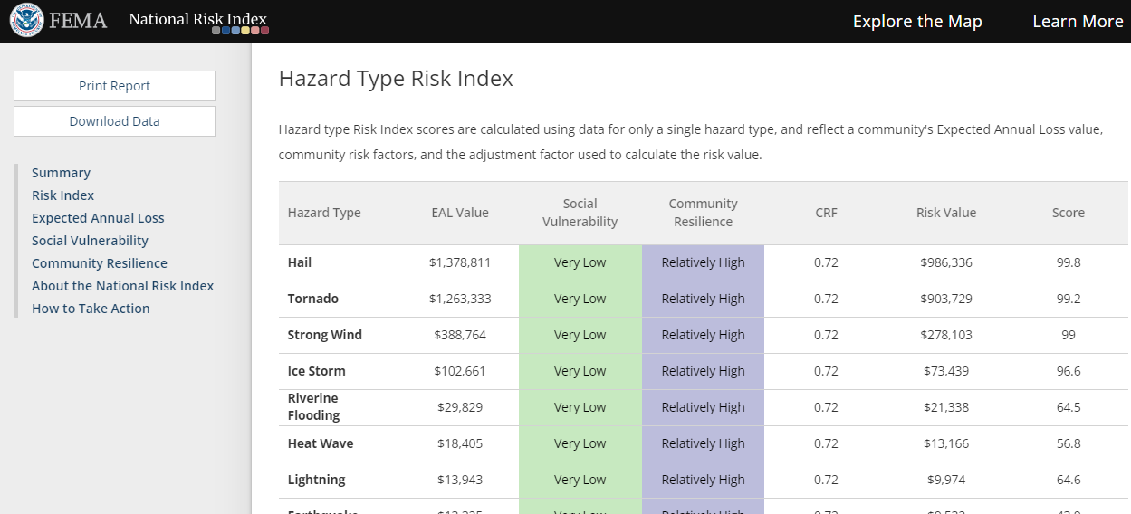
Elements of Risk
What proportion of the population?
How large of a geographic area?
Potential for disruption of utilities > 72 hrs.
Duration of incident?
Potential for injury or loss of life?
Potential for severe damage?
Potential to impact commerce?
Potential to disrupt communications?
Disproportionate cultural impact?
Public perception/fear?
Potential to disrupt transportation?
National Risk Index: https://hazards.fema.gov/nri/map

Slide 8
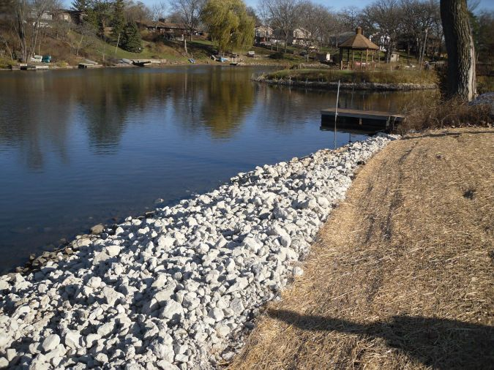
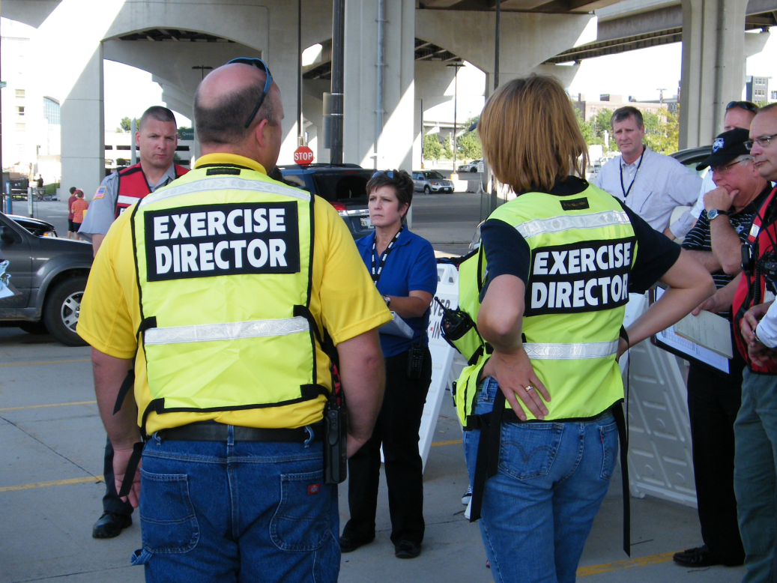
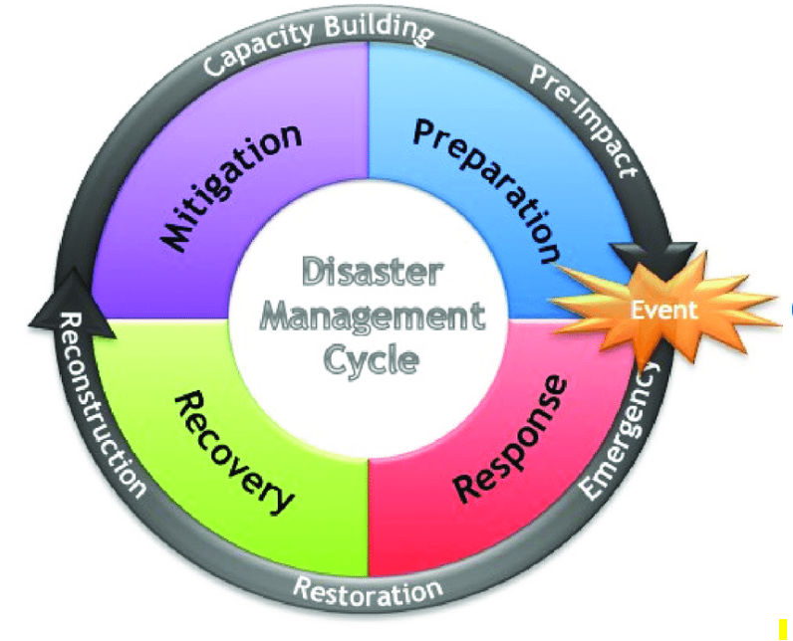
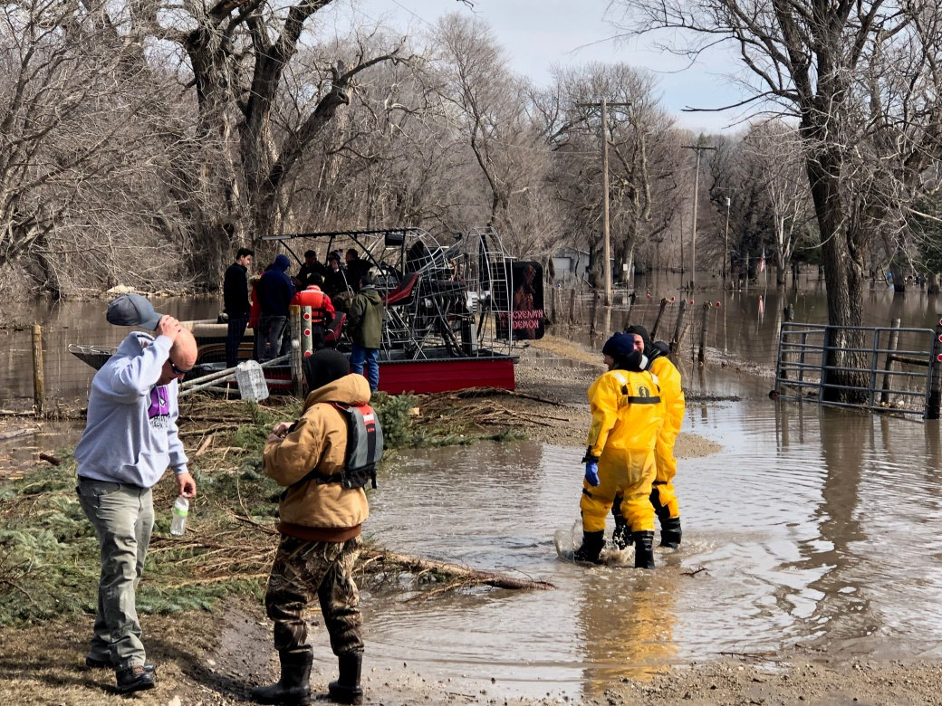
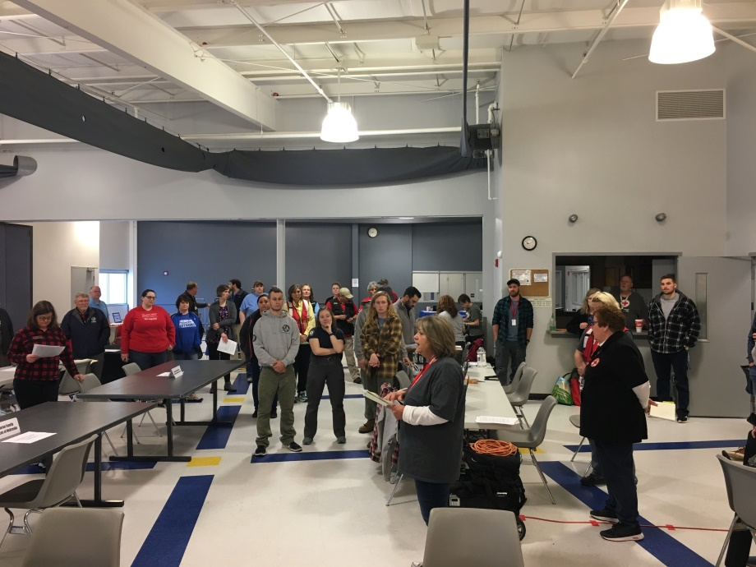

Slide 9
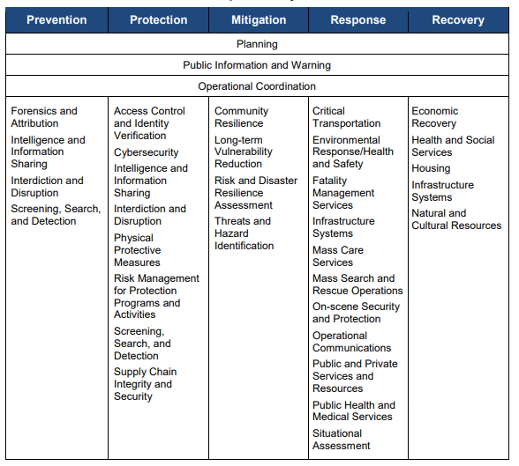
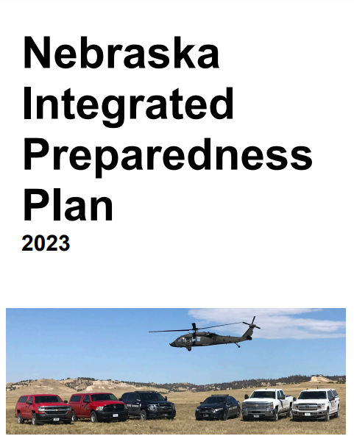
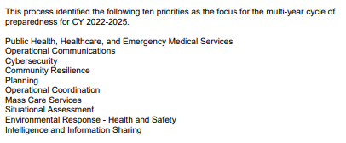
Preparedness

Slide 10
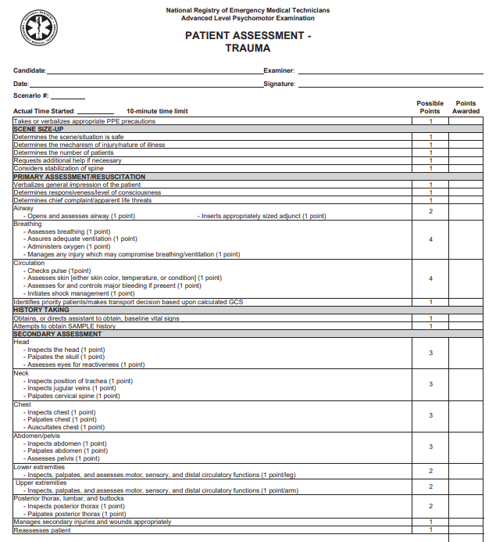
Patient Level
Personal Protection
Scene Size-Up
Primary assessment, immediate life-saving interventions
History taking
Secondary assessment/interventions
Continual reassessment
Transfer to definitive care
Similar process and priorities are applicable at the community level

Slide 11
Response

Slide 12
Did the incident disrupt service to survivors?
What is the extent of the disruption and impact on the response and survivors?
Has a solution to the disruption been identified?
Has that solution been converted into a plan of action?
Has that plan of action been resourced?
Are there limiting factors that are providing stabilization? To what extent are they degrading services?
Have services for survivors been stabilized? If not, how long to reach stabilization?
Are their contingency solutions that are enabling stabilization? How long will these solutions be used to sustain stabilization?
Have circumstances changed wince the lifeline/component was last assessed?

Slide 13
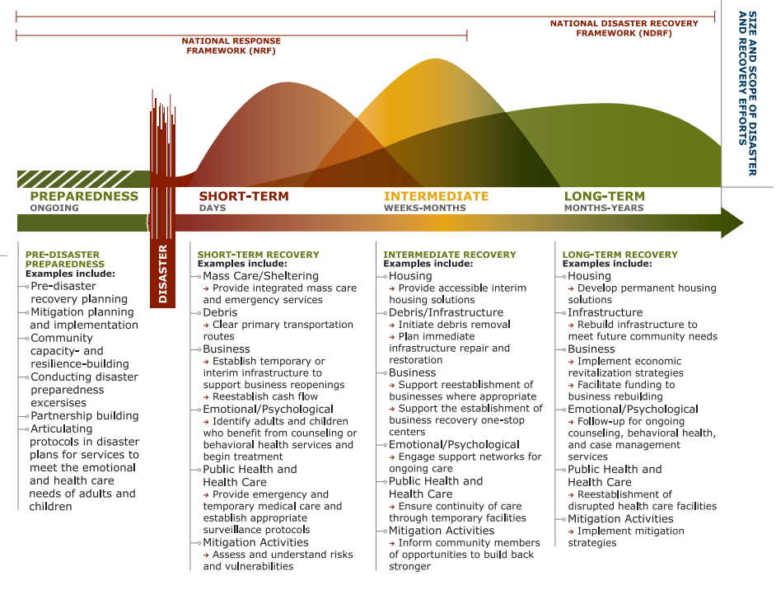
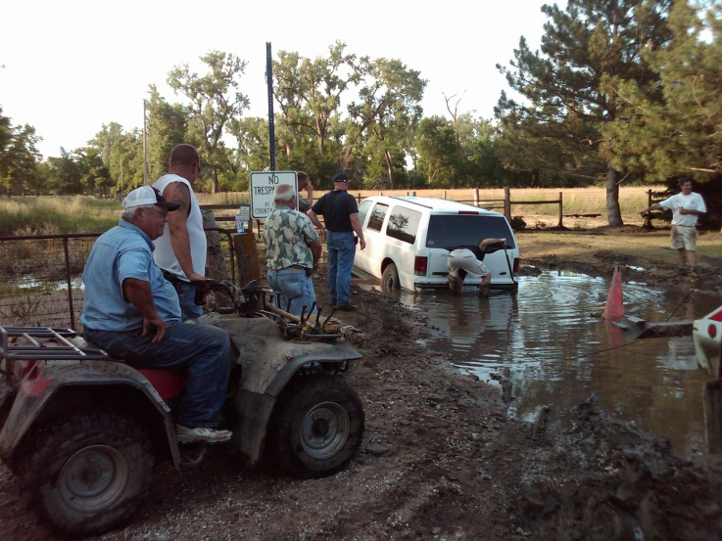
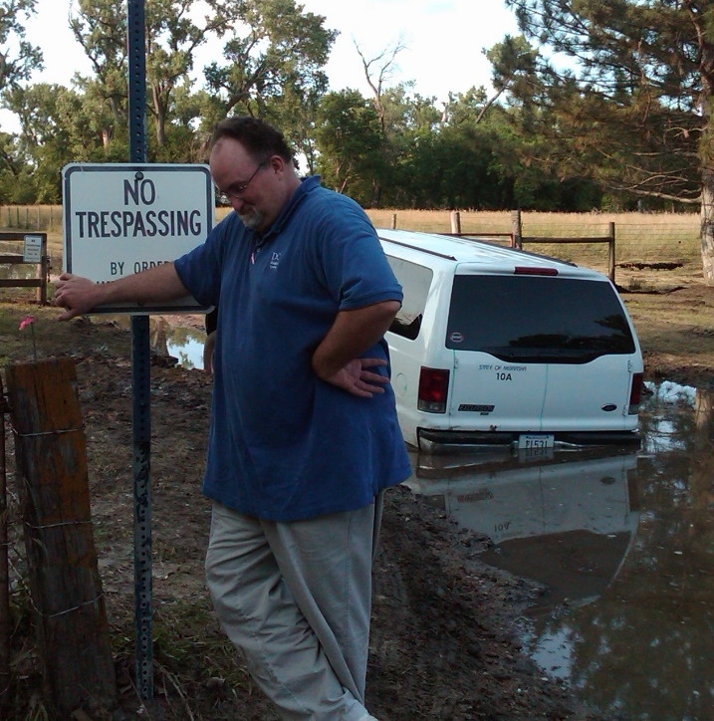
Recovery
Recovery
“The nine most terrifying words in the English language are: I’m from the Government, and I’m here to help.”
Ronald Reagan, 1986
Local Primacy

Slide 14
Mitigation

Slide 15
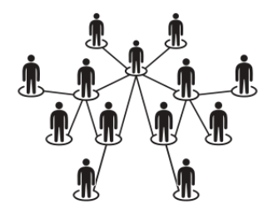
Douglas County – Command and Coordination
Emergency Management Senior Advisory Team
(MAC Group)
Joint Information Center (JIC)
Incident / Unified Command
(IC/UC)
Emergency Operations Center (EOC)
On-Scene or in Command Post/Center
Off-Scene, often convening virtually

Slide 16
LEVEL | FEMA CORE CAPABILITIES
Level 1 Monitoring & Exchange of Info | Situation Assessment Operational Communications
Level 2 Assessment of Risk with Proactive Measures | Situation Assessment Operational Communication | Operational Coordination Public Info and Warning
Level 3 Response with Local Resources and Level 4 Response with Outside Assistance | Planning Public Info and Warning Operational Coordination Situation Assessment Infrastructure Systems Critical Transportation Fatality Management Mass Care | Mass Search and Rescue Logistics and Supply Chain Management Environmental Response / Health and Safety Mass Search and Rescue On-Scene Security, Protection, and Law Enforcement Operational Communications Public Health, Healthcare and EMS Fire Management and Suppression
Recovery Short Term and Long Term | Planning Public Info and Warning Operational Coordination Infrastructure Systems | Economic Recovery Health and Social Services Housing Natural and Cultural Resources
How and by
whom are these capabilities met?
Levels of Emergency Operations Management Activation

Slide 17
Community Lifelines
SENIOR
OFFICIALS
LOCAL
EMERGENCY
MANAGEMENT
NEMA/
STATE AGENCIES
FEMA/
FEDERAL
AGENCIES
INCIDENT
COMMAND

Slide 18
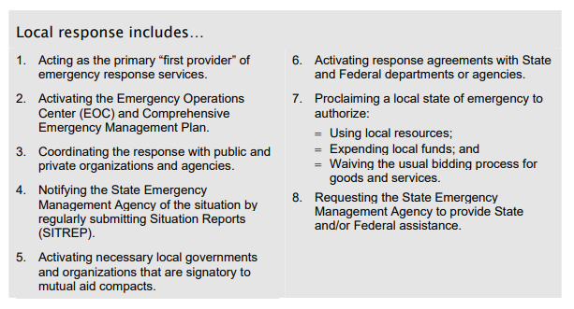
Perception
Disaster
Proclamation
*
Reality

Slide 19
Building Resiliency through
Whole Community Engagement

Slide 20
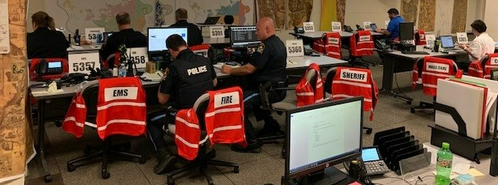
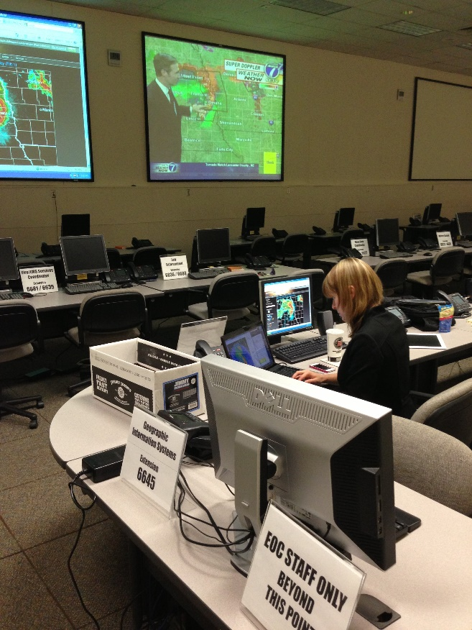
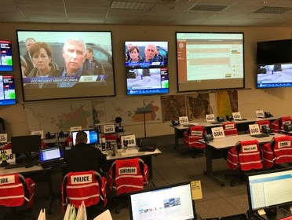
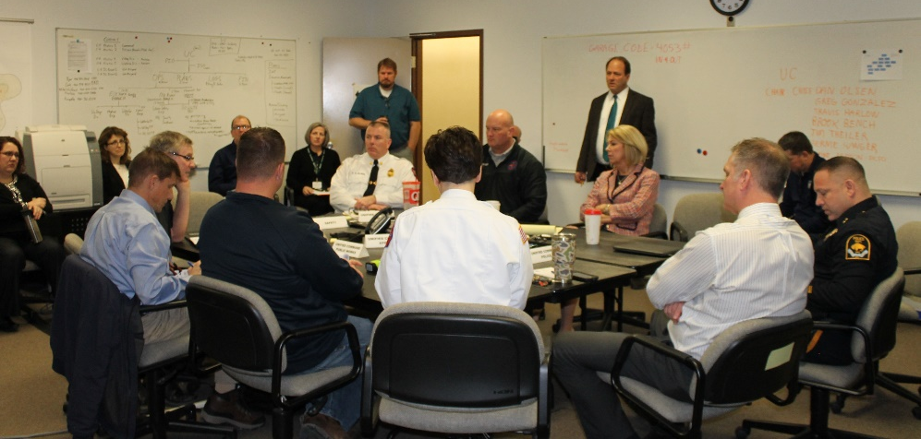
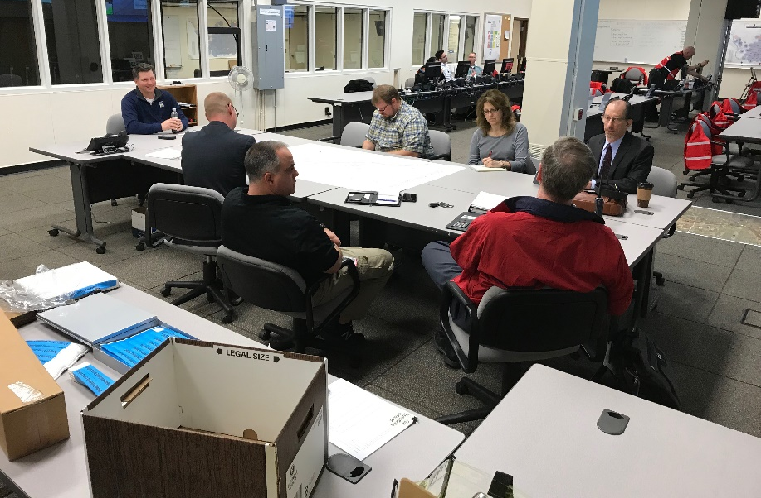
Douglas County
Emergency Operations Center

Slide 21
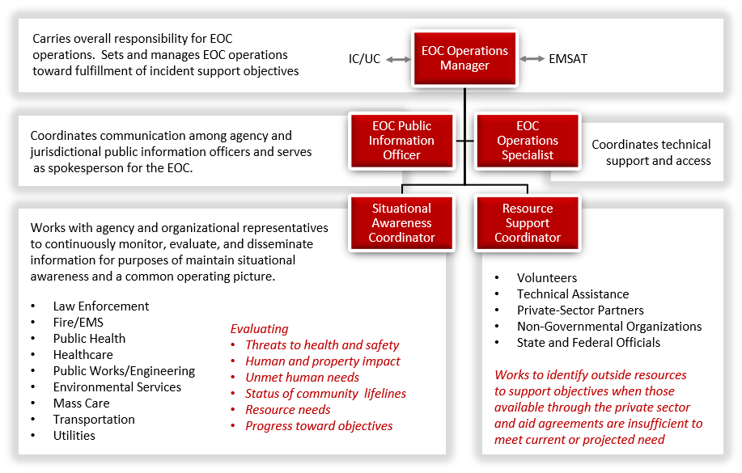
DOUGLAS COUNTY EOC OPERATING STRUCTURE

Slide 22
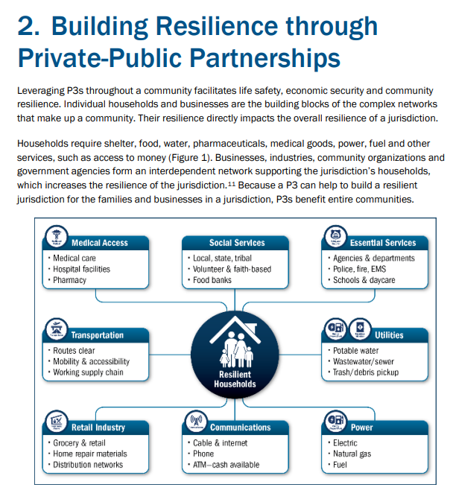

Slide 23
How might we be of assistance in meeting your mission?
Thank you!
Whitney Shipley
Whitney.shipley@douglascounty-ne.gov

